Slide 1
CAPTIONING

Slide 2
CLEAR CAPTIONING IS ANTHOR TEEHNIQUE THAT CAN MAKE EASY WORK OF FILLING A FROM CAPTIONS TELL THE COMPLETING THE FROM WHAT TO PUT IN BLANK LINE,SPACE, OR BOX.

Slide 3
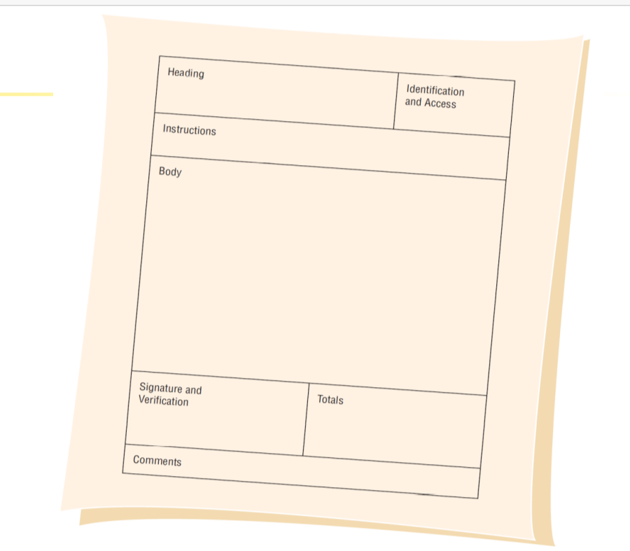
FIGURE 12.1 SEVEN SECTIONS FOUND IN WELL-DESIGNED FORMS

Slide 4
CAPTIONNING TYPES
Line caption
Putting the caption on the same line or below the line.
Advantage of putting caption below the line is that there is more room on the line itself for data.
Disadvantage is that it is sometimes unclear which line is associated with the caption: the line above or below the caption

Slide 5
Boxed caption
Providing a box for data instead of a line
Check off caption
Lining up choices or alternatives vertically
Horizontal check off caption
Lining up choices or alternatives horizontally
Table caption
Work well in the body of a form

Slide 6
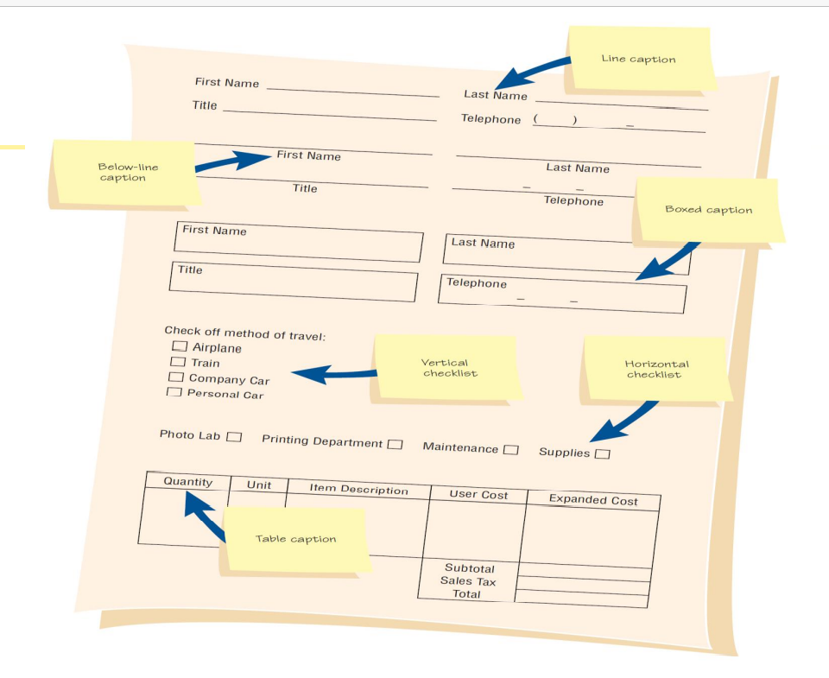
MAJOR CAPTIONING ALTERNATIVES

Slide 7
MEETING THE INTENDED PURPOSE
Systems analysts may use different types of specialty forms for different purposes
Specialty forms
Multiple-part forms that are used to create instant triplicates of data
Continuous-feed forms that run through the printer without intervention. Image Image1
Perforated form that leave a stub behind as a record when they are separated.

